Slide 2
Initial problem
Through this update, we will discuss how data exploration shaped our problem question + data cleaning / pre-processing

Slide 3
MSK-IMPACT is…
What is this dataset? What are the features here?
Specifically, what mutations are we looking at?

Slide 4
MSK-MET is…
What is this dataset? What are the features here?

Slide 5
MSK-CHORD is…
What is this dataset? What are the features here?

Slide 6
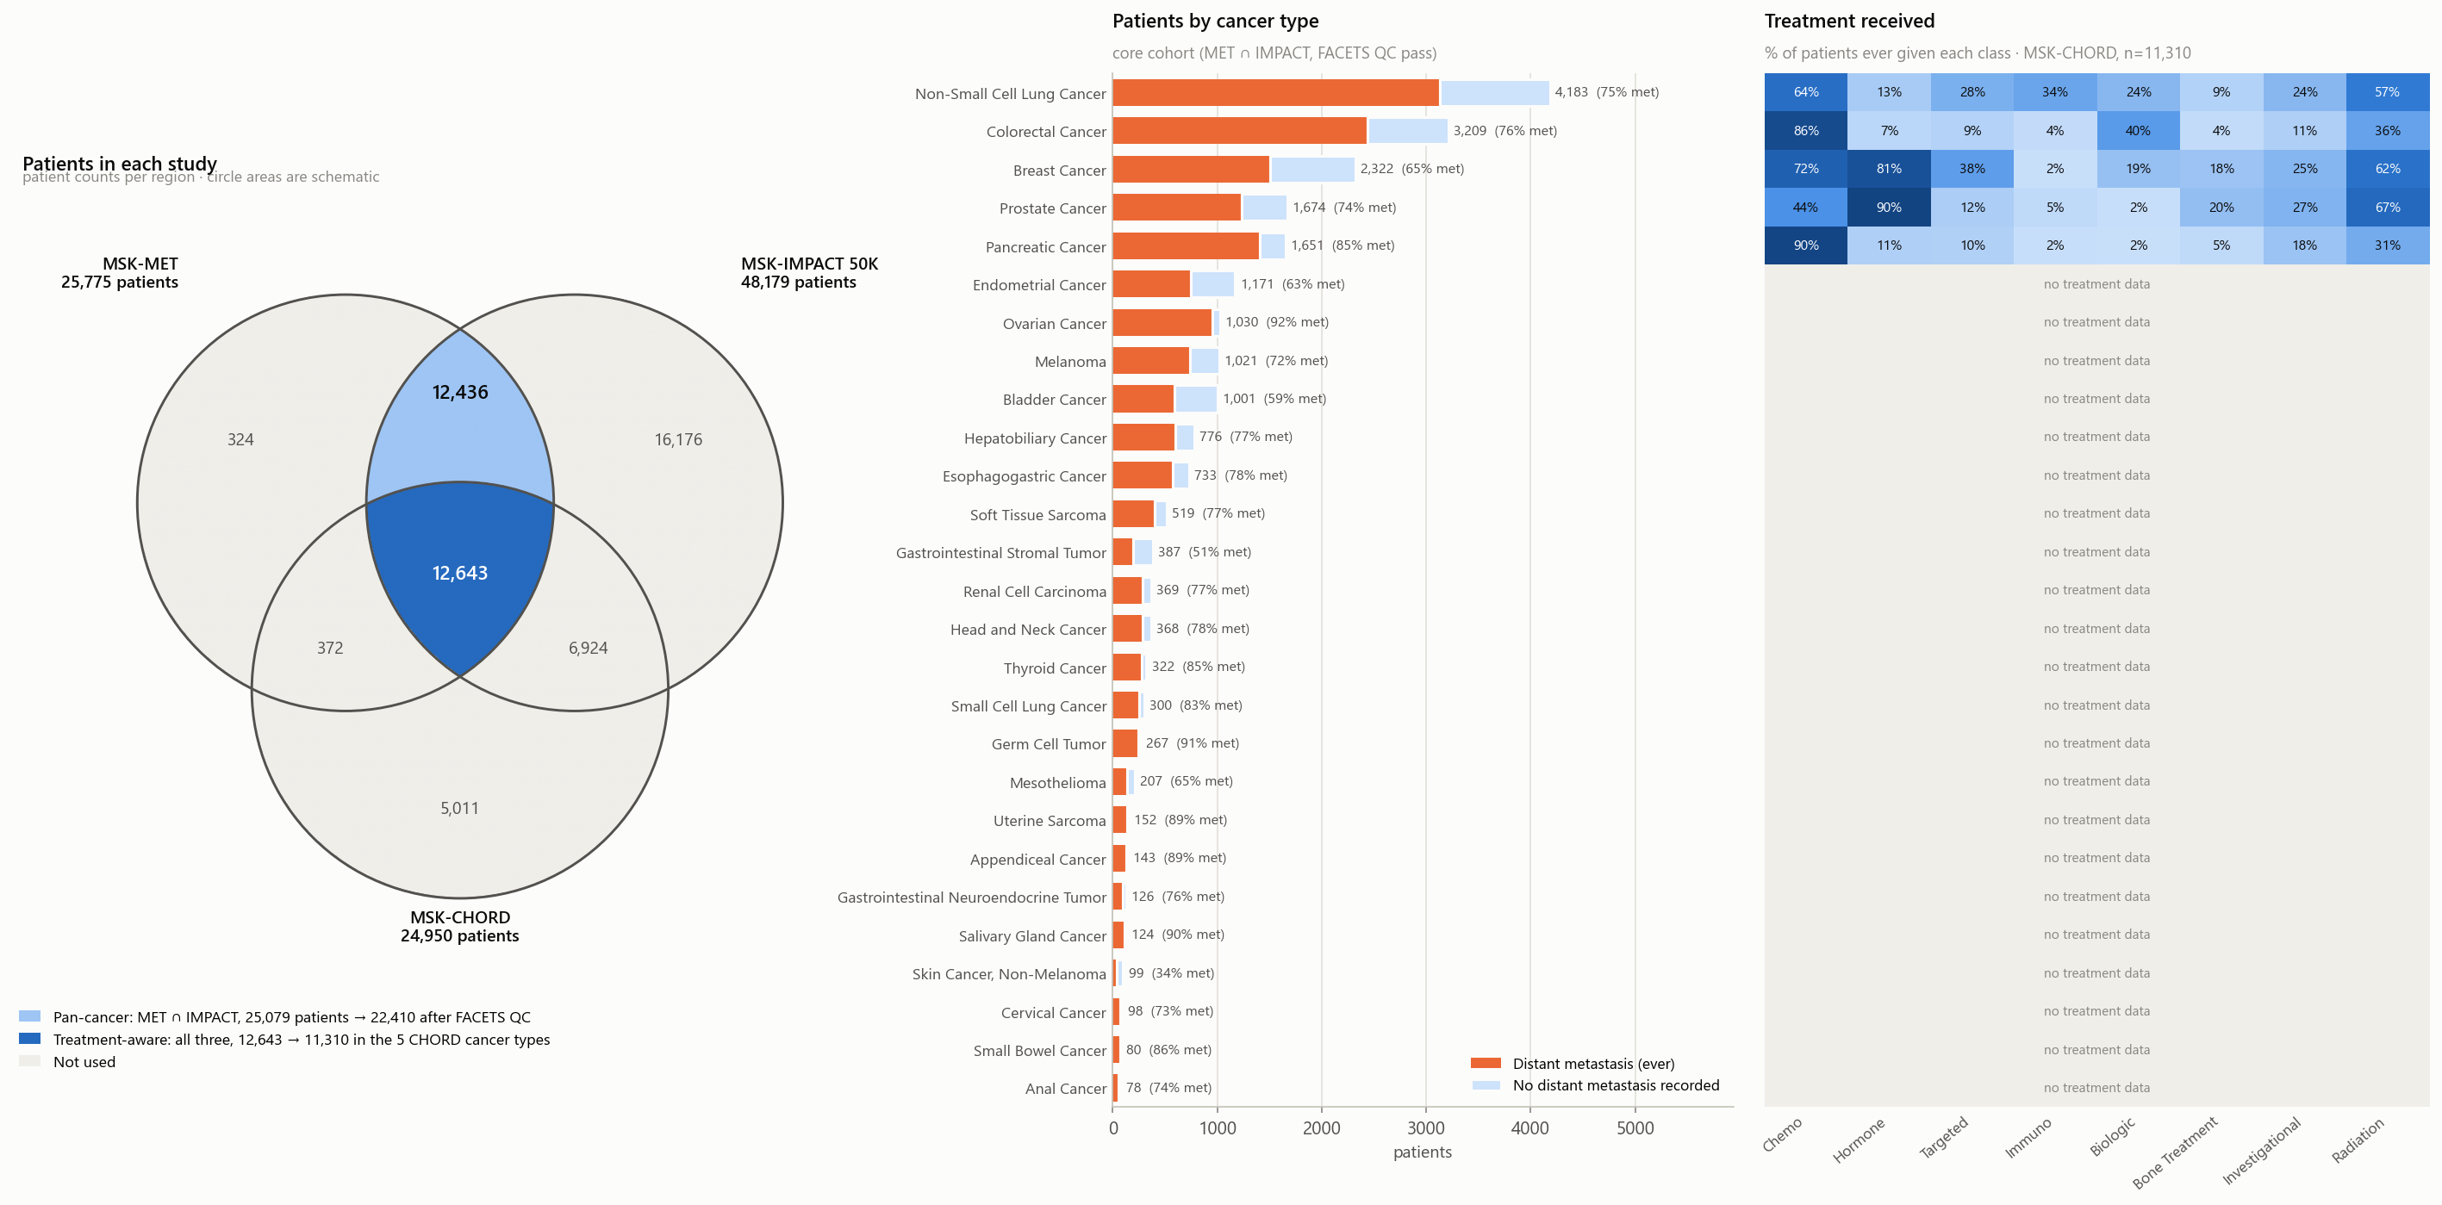
X patients from MET U IMPACT U CHORD with Y cancers

Slide 7
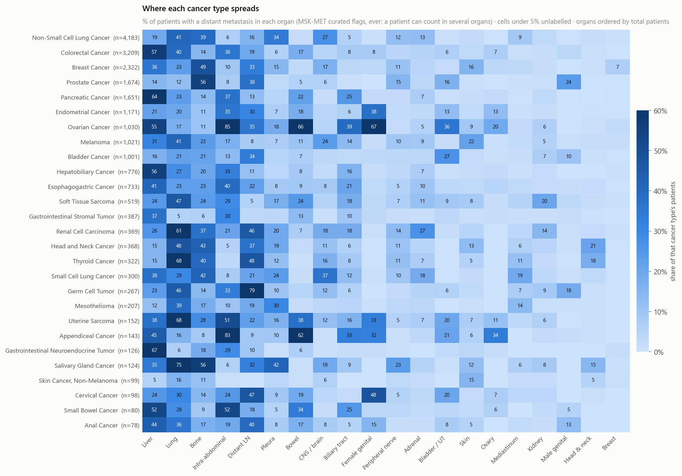
Metastasis overview

Slide 8
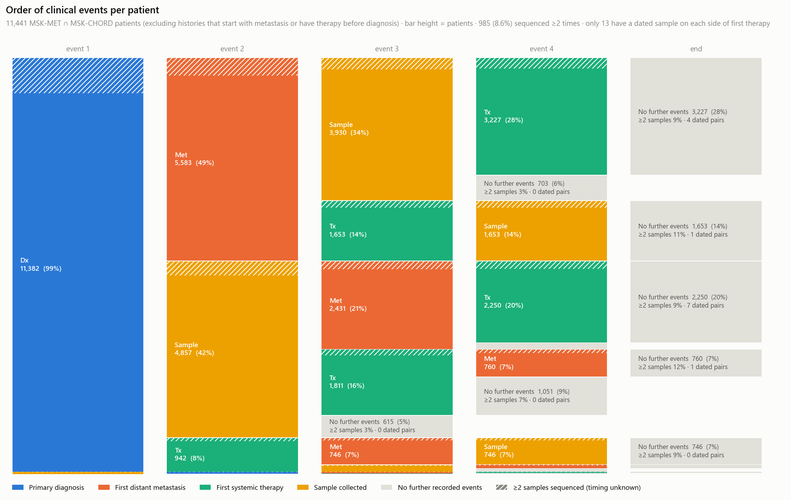
The order of clinical events varies per patient

Slide 9
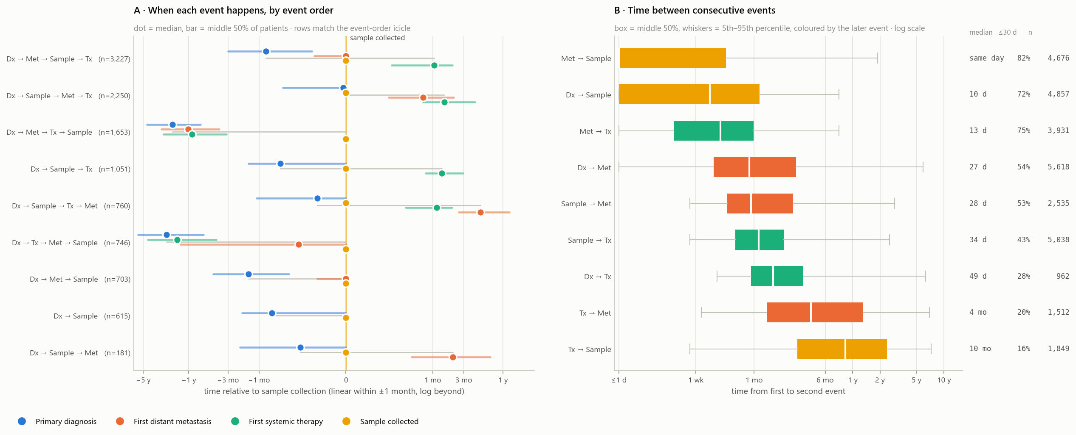
Timing between clinical events varies by person

Slide 10
Refined problem definition
Given a sample, can we predict if it is pre- or post- treatment?
On the subset where sample comes before met, can we predict where the met is given the sample?

